Slide 1

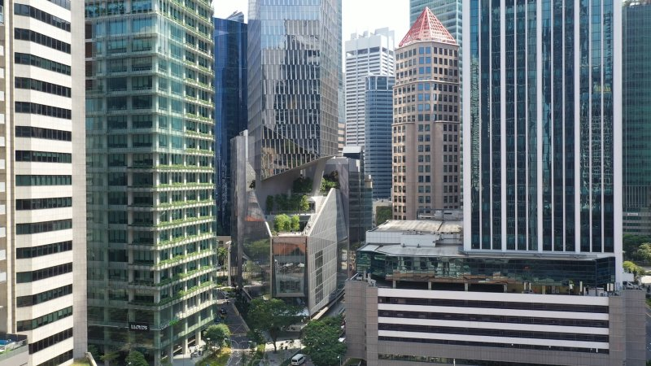
MIS & IT Operations of XYZ Company

Slide 2

SUPERVISOR
John Doe
Lecturer, Department of Computer Science and Engineering, ABC University
Reported
By
ID: 123456789
Name: Jane Park

Slide 3


Company Overview
Name of the Company: XYZ
Type:
R Service Oriented Organization
Established On:
1984
Company Formation: 1988
Field of Operations: Health Care
Manufacturing Establishment: Oxford street,
London
XYZ Corporate Offices:
XYZ Tower-1 & XYZ Tower-2
No of Sales Offices : 9
Wings:
XYZ (Holding) & XYZ Enterprise
Total Employees No.: 15,00
My Working Branch: Head Office. XYZ Tower, 221b Baker Street, London

Slide 4



MIS & IT Department’s Overview
Provides all kinds of technical support
Develop and maintain software
Develop and maintain web portals
Responsible for all types of hardware support
Maintain their own IT inventory
Database maintenance
Provide modern facilities

Slide 5




My Works
Hardware Related Works
Software Related Works
Learning Official Norms

Slide 6



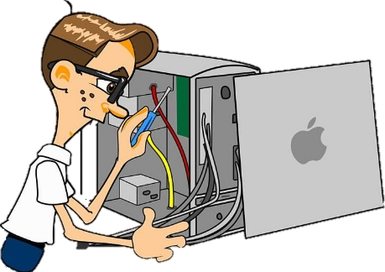
Hardware Related Works
Configure and Setup Computers and Laptops
Setup Thermal Printers
Setup Android Mobiles

Slide 7



Software Related Works
Setup OS to several computers
Install different kinds of software
Setup computers according to requirements
Add items to the software
National and Area based target update to software
Test G6 Android application
Test XYZSales app (Android application)

Slide 8



Other Works
Update Computer Accessories Distribution information to Excel
Update previous IT Items Details to Excel
Sales analysis report checking on software
Learn about Attendance Management System
District Report checking from software
Attend UAT(User Acceptance Test) meeting of mobile app.
#
#
#
#
#
#

Slide 9




Slide 10


Slide 11


Any Questions?

